Slide 1
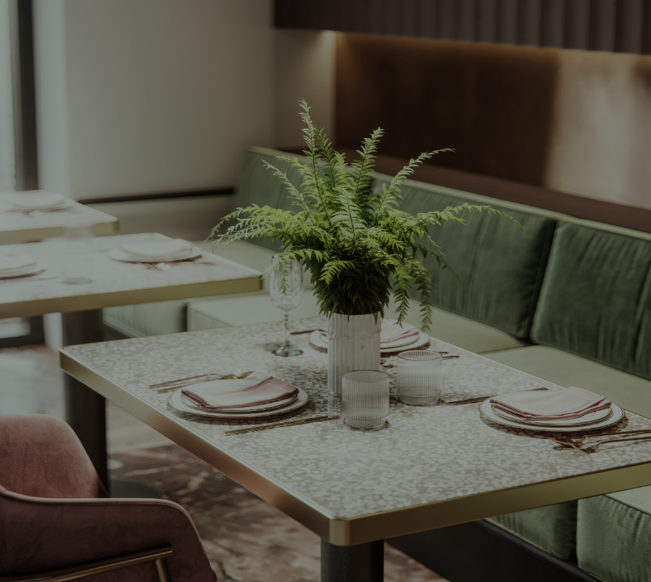
The pellicano
Step into luxury
Pallicano

Slide 2

About us
At The Pellicano we are on a journey of discovering and in some instances rediscovering “Locavore” traditions, cultures and its connection to our Mother Earth.
​
We hope to re-enact these stories through our culinary creations, encapsulating these forgotten traditions through futuristic adaptations in one of its kind food theatrics experience specially curated for you, a sustainable gastronomy.
​

Slide 3

requirement
2

Slide 4

General manager
Job description
a
Job specification
a

Slide 5
Executive chef
Job description
Our restaurant is seeking a passionate, skilled chef to create delicious meals for our patrons. You will be responsible for planning our menu, ensuring that each dish is nutritious and cost-effective, and collaborating with a team of kitchen staff to deliver food that meets the highest quality standards.
Job specification
Culinary school degree/diploma.
Past experience as a working chef.
Advanced knowledge of the culinary arts.
Portfolio of creative, unique dishes.
Great leadership and interpersonal skills.
Ability to run stocktaking and place orders for resupply.
Exemplary work ethic in a high-pressure environment.

Slide 6
waiter
Job description
a
Job specification
a

Slide 7
Sous chef
Job description
a
Job specification
a

Slide 8
barrista
Job description
a
Job specification
a

Slide 9
security
Job description
a
Job specification
a

Slide 10
Cleaning staff
Job description
a
Job specification
a

Slide 11
receptionist
Job description
a
Job specification
a

Slide 12
accounting
Job description
a
Job specification
a

Slide 13

Thank You
Than

